Slide 1
Inter-Display Protocol

Slide 2
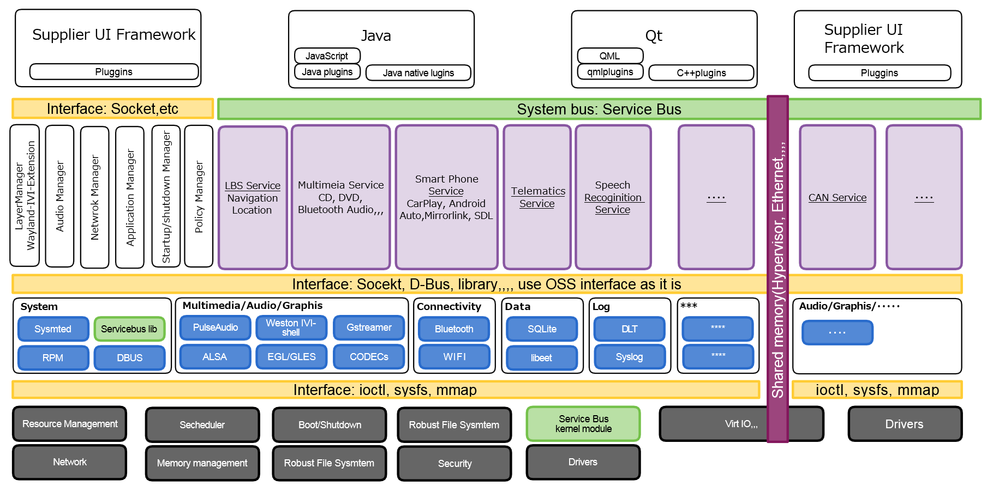
Use Case and Requirement
Multimedia ECU
Instrument cluster
ECU
The cockpit system consists of
Multiple ECUs.

Slide 3
Use Case and Requirement
There is use case and requirement to display surface to several display inter ECUs.
Multimedia ECU
Instrument cluster
ECU
Display map
Display inter section enlarge view

Slide 4
Use Case and Requirement
There is use case and requirement to display surface to several display inter ECUs.
Multimedia ECU
Instrument cluster
ECU
Telematics
information
Traffic Jam information

Slide 5
Use case and Requirement
https://wiki.automotivelinux.org/eg-ui-graphics-req-graphics
There will be more Use cases for Inter Display protocol as more useful navigation/telematics data come, connecting internet.

Slide 6
Standardization: which part?
Multimedia ECU
Instrument cluster
ECU
Telematics
information
Traffic Jam information

Slide 7
Inter Display protocol Standardization
Multimedia ECU
Instrument cluster
ECU
Telematics
information
Traffic Jam information
Standard Protocol at Wayland/Weston

Slide 8
Overview: Inter Display protocol with Wayland/Weston
Now way to share surface inter ECUs/OSs….
HMI
Controller
ivi-shell
HMI
Controller
ivi-shell
Transmitter Plugin
Weston Core
Weston Core
Weston Backend
Weston Backend
Input devices
Input devices

Slide 9
Overview: Inter Display protocol with Wayland/Weston
Define Protocol at Wayland protocol to be upstreamed
Receiver
Daemon
HMI
Controller
ivi-shell
Transmitter Plugin
HMI
Controller
ivi-shell
Transmitter Plugin
Weston Core
Weston Core
Weston Backend
Weston Backend
Input devices
Adaptation Plugins
Adaptation Plugins
Input devices
Implementation of reference protocol
RTP
LVDS
Ethernet AVB,,,

Slide 10
Summary
Inter Display protocol is really mandatory for near feature to collaborate with ECUs.
Wayland/Weston community is the best place to be upstreamed.
Define Inter Display protocol
Reference implementation to share physical memory needs to be adapted for each users preferable.
At first, Linux <-> Linux environment.
To be proposed to SAT as AGL activity.
TODO: collaboration with Security framework.

