Slide 1
Containers & Mesh EG
Cloud-Native Computing on Automotive Grade Linux
Nenad Ilic
Developer Advocate – AWS IoT Amazon Web Services
nenailic@amazon.com

Slide 2
Agenda:
Challenge facing Automotive Industry
Scope of the Containers & Mesh Expert Group
AGL on AWS
Expert group roadmap for the next months

Slide 3
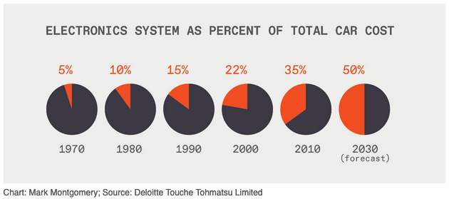
Trends and Challenges driving the need for an SDV strategy
Connected
Autonomous
Shared
Electrification
Safety features
Quality and security
Wiring harness costs
Integration testing, V&V
Regional regulatory differences
Supply chain fragility
Innovation
https://spectrum.ieee.org/cars-that-think/transportation/advanced-cars/software-eating-car
Notes:
No other industry is undergoing such a massive technological change as automotive. Historically, automotive OEMs have competed and differentiated themselves with mechanical features like horsepower, ride handling, braking, and eye-catching physical design. Today, we see OEMs compete over the implementation and availability of advanced driver assistance systems (ADAS) features like lane-keeping, start and stop adaptive cruise control, Autopilot (Tesla) and SuperCruise (Cadillac), as well as sophisticated infotainment systems with mobile phone-like user experiences. A shift from single purpose electronic control units (ECU) to more consolidated, high performance computing (HPC) architectures are making this possible. Combine this with the move to electric powertrains and need for high-bandwidth networking to support AV sensor feeds, fundamental changes in vehicle architectures are required.
From the safety feature perspective, you have stability control, backup cameras, eCall, and even emissions standards. These all require sophisticated software, whereas in the past, vehicles had really simple electronic actuators with simple on off statuses.
Looking at the volume of data flowing on the networks in the vehicle, there can be 25 GB of data exchanged per hour in a cutting-edge vehicle today. This is before adding rich sensor data captured from Autonomous inputs like video and lidar.
OEMs shoulder the burden of integration testing of the various ECUs they acquire from the large supplier base. In many cases, they treat the ECUs like black boxes - They know the device uses so much power and requires particular data inputs and its outputs - that's it. The OEM is responsible for the system testing and integration of all these devices into a working vehicle and when you complicate it with the various models, carlines and option packages it creates a complex problem space for testing and validation.
On top of this, electronics systems (hardware and software) as a percent of total vehicle development cost is predicted to rise to 50% by 2030. Right now, testing alone is 40% of the vehicle production costs.
Regulatory issues like emissions and ADAS system functions can vary by country and even by state in the US. Vehicles in Europe with L3 capabilities need to be certified by each country because the the various road sign standards, rules of the road, and even language differences. All of this complicates the production vehicle and requires multiple software versions and over the air deployment capabilities to operate.
Recent events have exposed the fragility of the Automotive supply chain and its reliance on a complex web of semiconductor components. All the various suppliers for different ECUs use different chipsets and when you combine this you have a logistical nightmare when your supply chain is disrupted like what happened with the pandemic. If we had fewer ECUs and more consolidated runtimes, it would expose the OEMs to less disruption naturally.

Slide 4
What is “Software Defined”? How to make it possible?
ADAS/AV
Gateway
Infotainment
Functions enabled by software are abstracted from hardware
Functions are enabled using a cloud-native microservices development model:
Delivered as self-contained units of software (virtual ECU packaged in containers)
Mechanism for publishing available services and their interfaces and characteristics
Authorization of the use of these services by other functions
Functions are continuously updatable over the air
Hardware Abstraction
Hardware
Develop in Cloud and deploy into in-vehicle hardware
Notes:
An automotive computing platform whereby software is completely abstracted from the underlying commoditized hardware and deployed on a consolidated high performance zonal computing architecture that enables continuous development and deployment of vehicle functions through over the air software updates using cloud native technologies.
Containers are getting traction across the industry – but existing solutions (direct on hypervisor) don’t enable the control or flexibility we see with container orchestration frameworks offboard.

Slide 5
Architectural considerations for Software Defined Vehicles
HW Consolidation & Virtualization
By virtualizing the sensors, networking, and hardware interfaces, customers can achieve parity between cloud and vehicle
In-Vehicle Microservices
Provide a normalized, consistent, secure data access layer that allows developers to create new insights & microservices
Application Encapsulation
Containers provide self contained, isolated, easily distributable packages for development of virtual ECUs deployed to vehicles
Automotive DevOps
Agility with managed CI/CD to more rapidly and reliably build and deliver services inside the vehicle
Mixed-critical management of workloads from edge-to-cloud
Environmental parity and optimized execution environment
Application-level networking to discover services and enable communication across multiple types of compute infrastructures
Notes:
Key point is that by abstracting hardware from software, you can simplify development for services in vehicle, speed up test and validation stages, and improve the accuracy of these tests.

Slide 6
In-vehicle hardware consolidation enables cloud native
Traditional Architecture
Domain Architecture
Zonal Architecture
In-Car High Performance Computer
ECU
ECU
ECU
ECU
ECU
ECU
ECU
ECU
ECU
Central Compute
Central Compute
ADAS/AD
Domain Controller
ECU
ECU
ECU
ECU
ECU
ECU
IVI/Cluster Domain Controller
Powertrain Domain
Controller
Zonal Gateway
Ethernet TSN Switch
Ethernet TSN Switch
Zonal Gateway
ECU
ECU
ECU
ECU
ECU
ECU
ECU
ECU
ECU
ECU
Lidar
Zonal Gateway
Zonal Gateway
Actuators
ECU
ECU
ECU
ECU
ECU
Radar
IMU
Radar
IMU
The shift towards centralized architectures is leading to “Datacenter on Wheels” design paradigm paving the way to cloud native software in automotive
Notes:
Electric and Electronic Architecture Progression
traditional architecture on the left has 100+ ECUs with tons of wiring between them
Wiring harness costs are huge when you consider all the various ECUs needs to connect to the vehicle network to operate and share the data produced from its operation. There are approximately 5000 meters of wiring in a car which is at least 3 miles long and adds 150 pounds. This will actually increase in the short term with domain controller-based solutions because the wiring to the various domains needs to be home run to each, which adds more weight and cost. Once we get into zonal architectures this will start to go down as we consolidate connectivity from the sensos and actuators to zonal concentrators and then into centralized switches.

Slide 7
In-vehicle hardware consolidation enables cloud native
Traditional Architecture
Domain Architecture
Zonal Architecture
In-Car High Performance Computer
ECU
ECU
ECU
ECU
ECU
ECU
ECU
ECU
ECU
Central Compute
Central Compute
ADAS/AD
Domain Controller
ECU
ECU
ECU
ECU
ECU
ECU
10/100/
1G TSN Link.
10/100/
1G TSN Link.
IVI/Cluster Domain Controller
Powertrain Domain
Controller
Zonal Gateway
Ethernet TSN Switch
Ethernet TSN Switch
Zonal Gateway
ECU
ECU
ECU
ECU
ECU
ECU
ECU
ECU
ECU
ECU
Lidar
Zonal Gateway
Zonal Gateway
Actuators
ECU
ECU
ECU
ECU
ECU
Radar
IMU
Radar
IMU
The shift towards centralized architectures is leading to “Datacenter on Wheels” design paradigm paving the way to cloud native software in automotive
Notes:
Domain architectures which are starting to appear in vehicles that you buy today
these are consolidated into around 3-5 domains
But customers during covid have fast tracked to more Hybrid domain architectures like you see in the picture in the center
Sometimes they will refer to this as a cluster of high performance compute
Each domain computer is different from the other and sourced possibly from three different suppliers
May have some aspects of zonal to take advantage of reduced wiring costs
Zonal HPC for SDV
Customers are working toward this architecture in the future
HPC computer, at least two to address high availability placed in different parts of the vehicle
4 distinct zones with all wiring consolidated to reduce costs and complexity

Slide 8
In-vehicle hardware consolidation enables cloud native
Traditional Architecture
Domain Architecture
Zonal Architecture
In-Car High Performance Computer
ECU
ECU
ECU
ECU
ECU
ECU
ECU
ECU
ECU
Central Compute
Central Compute
ADAS/AD
Domain Controller
ECU
ECU
ECU
ECU
ECU
ECU
IVI/Cluster Domain Controller
Powertrain Domain
Controller
Zonal Gateway
Ethernet TSN Switch
Ethernet TSN Switch
Zonal Gateway
ECU
ECU
ECU
ECU
ECU
ECU
ECU
ECU
ECU
ECU
Lidar
Zonal Gateway
Zonal Gateway
Actuators
ECU
ECU
ECU
ECU
ECU
Radar
IMU
Radar
IMU
The shift towards centralized architectures is leading to “Datacenter on Wheels” design paradigm paving the way to cloud native software in automotive
Notes:
Domain architectures which are starting to appear in vehicles that you buy today
these are consolidated into around 3-5 domains
But customers during covid have fast tracked to more Hybrid domain architectures like you see in the picture in the center
Sometimes they will refer to this as a cluster of high performance compute
Each domain computer is different from the other and sourced possibly from three different suppliers
May have some aspects of zonal to take advantage of reduced wiring costs
Zonal HPC for SDV
Customers are working toward this architecture in the future
HPC computer, at least two to address high availability placed in different parts of the vehicle
4 distinct zones with all wiring consolidated to reduce costs and complexity

Slide 9
Cloud-Native Computing?
Cloud Native Computing Foundation (CNCF)
Linux Foundation project founded in 2015 to advance container technology and align the tech industry around its evolution
Launched with Kubernetes 1.0
Now covers key container and service mesh technologies

Slide 10
Scope of the Containers & Mesh Expert Group
Container orchestration across single or multiple nodes inside and outside the vehicle
Application management: service deployment and update over-the-air
Application layer networking (eg service mesh) for container-based microservices
Collaborate closely with Virtualization EG, including bringing AGL to AWS EC2
Initial efforts ISO26262 QM only, for mixed-critically need to run containers on hypervisor

Slide 11
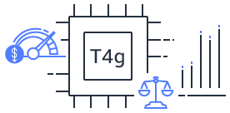
July 2022
Initial AMI is in private access only, but potential exists for this to be published to a public audience
AWS Cloud
AWS CodePipeline
Build Server – Graviton EC2
Build AGL for cloud target machine
Write image to Elastic File Service (EFS - network store)
Create Amazon Machine Image (AMI) from EFS volume and share
EC2 Public AMI
Cloud AGL vECU
Multiple ‘virtual ECUs’ – AGL virtual machines running on Amazon EC2 hypervisor Nitro – can be instantiated using the public AMI, with public or private access
Cloud AGL vECU
Cloud AGL vECU
Containerized Test app

Slide 12
Containerized App
AWS Cloud
AWS CodePipeline or Jenkins to Orchestrate CICD PIpeline
Containerized Application Built and published to Container Repository
Container update orchestrated via Kubernetes API server in vehicle, with comms passed via gateway
Test suite ran against cloud-hosted vECUs
On success, containerized apps pushed to edge
Cloud AGL vECU
Cloud AGL vECU
Cloud AGL vECU
K8S Control Node/Gateway
IC Guest VM
IVI Guest VM
Cloud Gateway
Kubernetes API Server
Containers orchestrated within VMs via Kubernetes agents
~Dec 2022
Working with Virtualization EG for a cloud-to-vehicle edge container orchestration proof of concept.
Automotive Edge
Cloud AGL vECU
Cloud AGL vECU
Cloud AGL vECU
K8S Control Node/Gateway
IC Guest VM
IVI Guest VM
Cloud Gateway
Kubernetes API Server
Containers orchestrated within VMs via Kubernetes agents

Slide 13
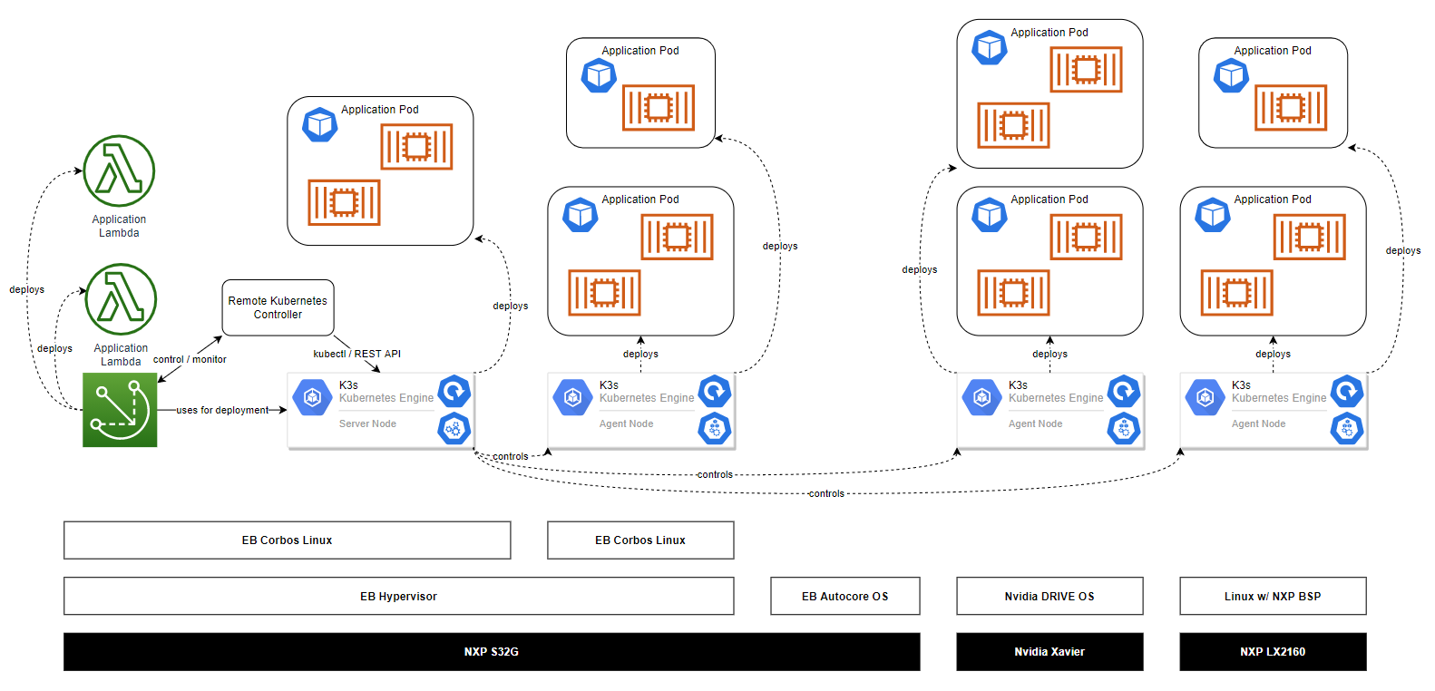
Customer Example
Linux 1
Linux 2
Hypervisor
RTOS

Slide 14
Thank you

