Slide 1
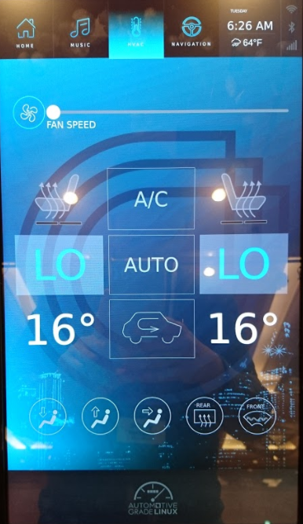
Speech HVAC demo idea
Use Microchip MOST MIC(directional microphone)
Supports English / French speech
Control Right/Left seat air condition(HVAC)
Left Seat
Right Seat
Say “Il fait froid”
Say “hot”
Left microphone is French
Right microphone is English
MOST MIC
AGL Voice Service and Voice Agent
Set Hot temperature left sheet
Set Cold temperature right sheet

Slide 2
Speech HVAC demo idea
How to get directional mic information ?(Microchip)
How to configuration multi langrage ?(Alexa)
HVAC
Apps
How to update temperature
indicator ?
Set temperature event
HVAC
service
High level voice
Temperature and Seat information
VR
Agent
4A
alsa
Set Left temperature
Set Right temperature
Left side directional mic
Right side directional mic
most
driver
sllin
driver
MOST
LIN
Micro phone
FAN

